Slide 1


FRAMES SDM Project Builder
Tutorial

Slide 2
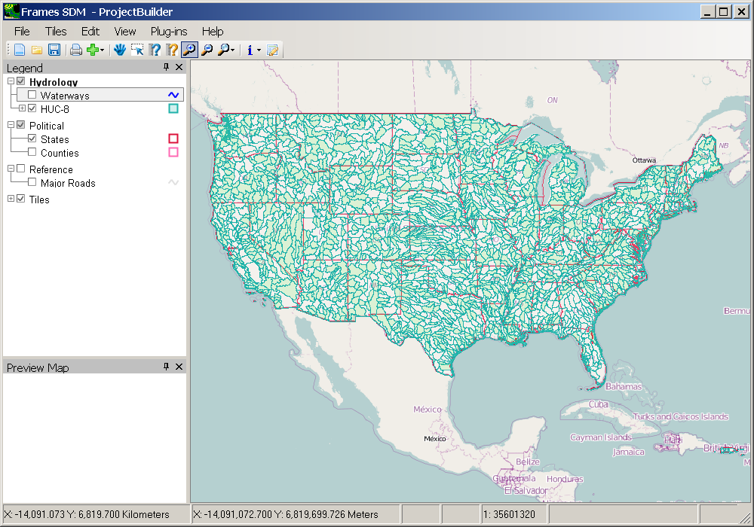
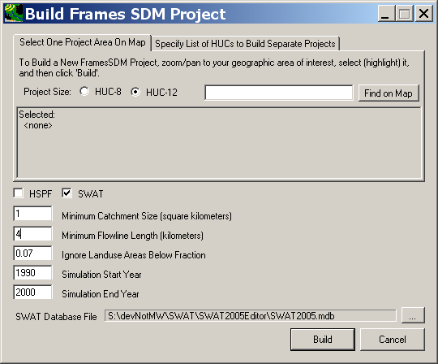
User’s Interface Components:
  Interactive Map of the Continental US, with capabilities to pan, zoom, turn layers on/off
  Specification window showing names of selected features, which models to set up, and a few parameters governing the model simulations to be created.

Slide 3
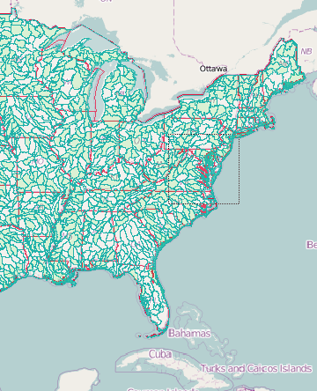
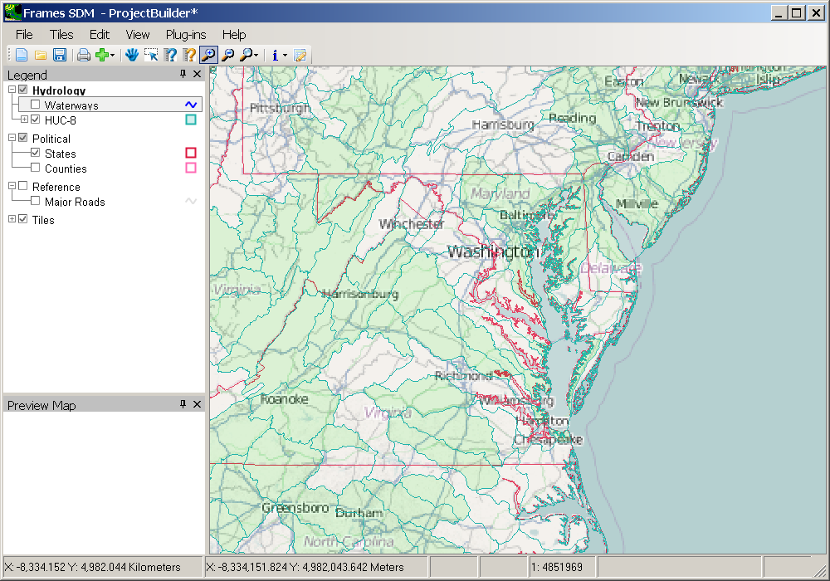
Selection of HUC-8
Zoom to Area of Interest …
  Use the Zoom tool to drag a box around the approximate area of interest, in this case the region surrounding the state of Maryland
  Notice that headwater HUC-8s are filled with a green color

Slide 4
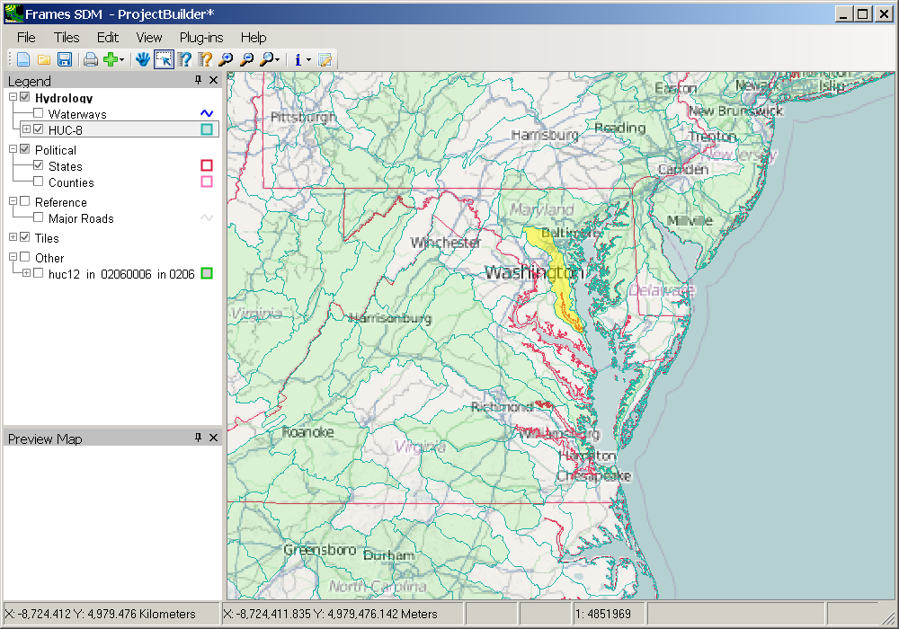
Selection of HUC-8
Then Select the Desired HUC-8
  Switch to the Selection Tool
  Click on the Patuxent Watershed on the map as shown highlighted on the map

Slide 5
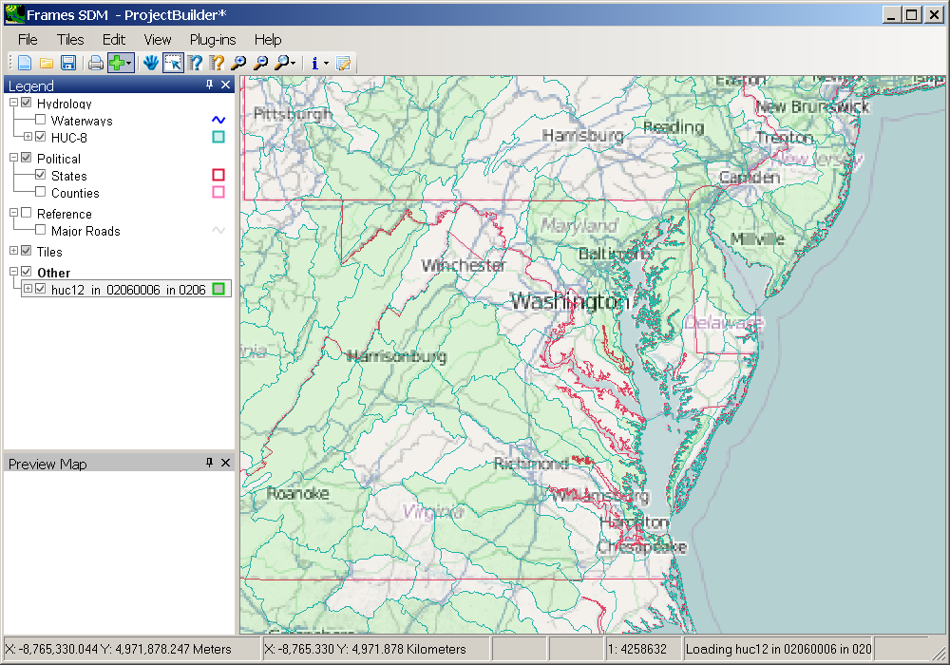
Automatic Loading of HUC-12s
  The HUC-12 layer for the Patuxent Watershed will automatically load

Slide 6
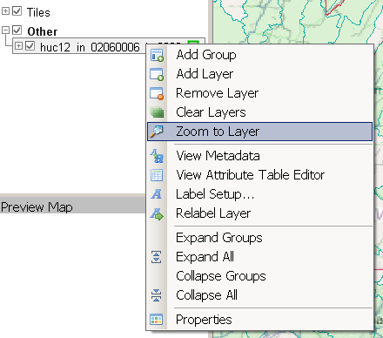
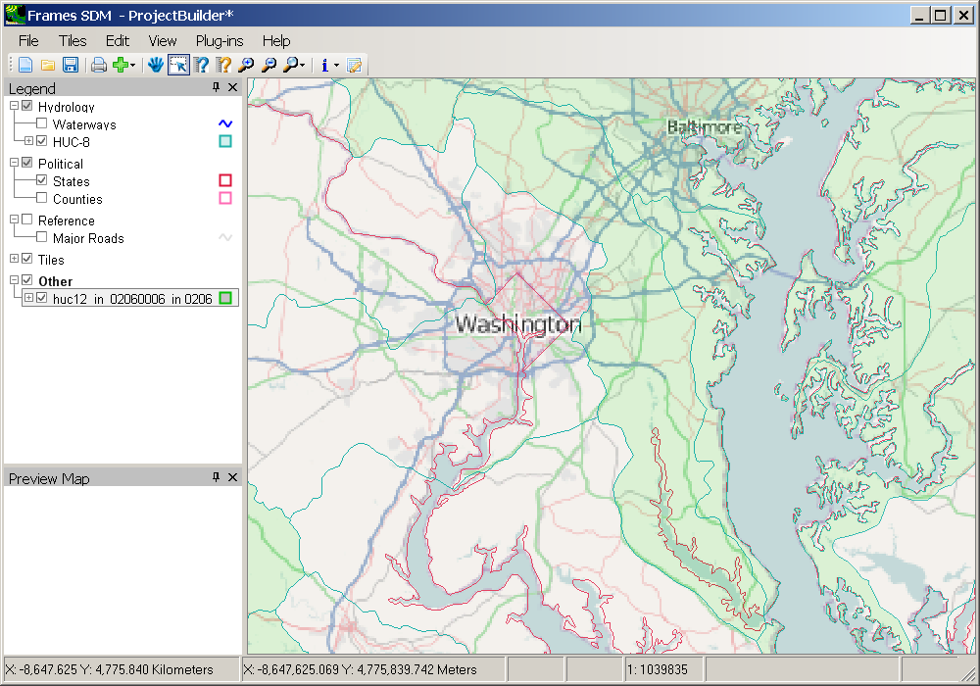
Selection of HUC-12
First, zoom to the new HUC-12 layer …
  With the new HUC-12 layer selected in the legend, right-click and select ‘Zoom to Layer’

Slide 7
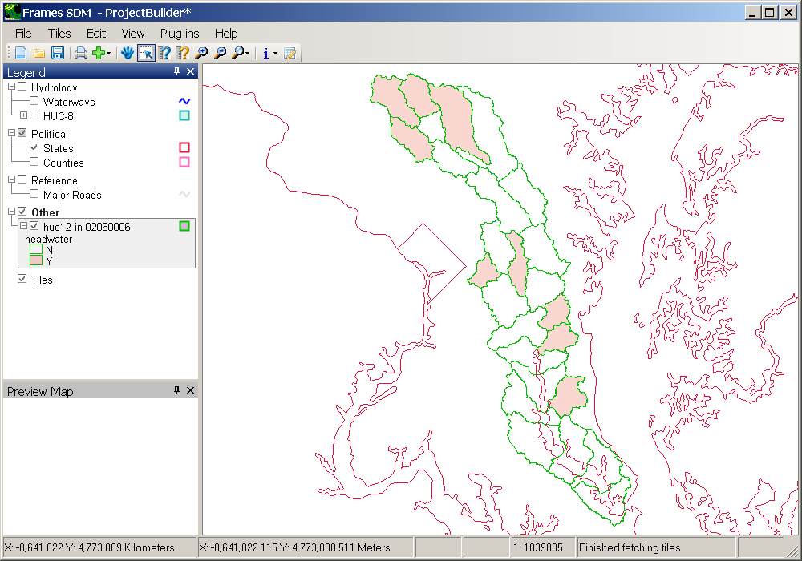
Selection of HUC-12
Adjust the view as desired …
  Check ‘off’ the HUC-8 layer and the Tiles to make the display clearer
  Click the ‘+’ on the HUC12 layer in the legend to show the symbology for this layer
  Notice that the headwater HUC12s are displayed in light red

Slide 8
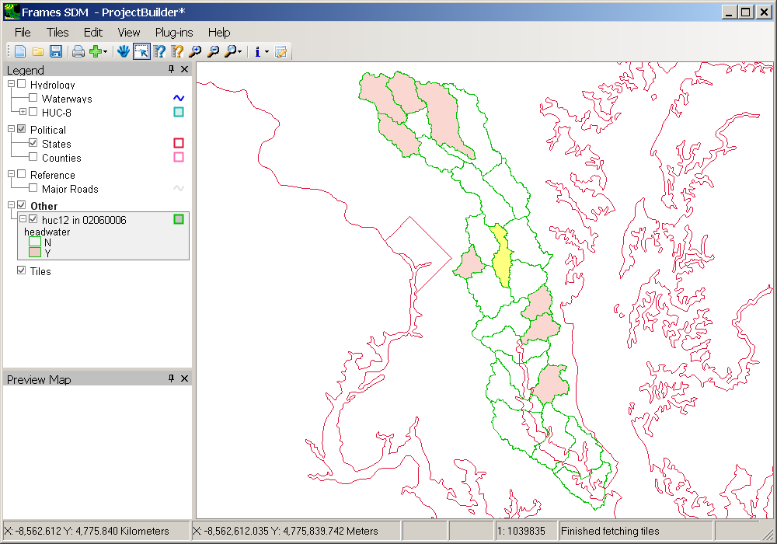
Selection of HUC-12
Then select the desired HUC-12
  Switch to the Selection Tool
  Click on the Collington Branch on the map as shown highlighted

Slide 9
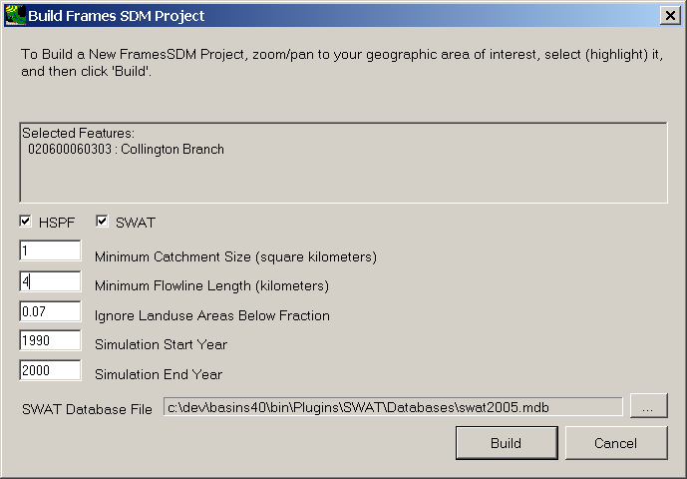
Enter Specifications
  Notice that the Collington Branch is shown as the ‘Selected Feature’
  Change the Minimum Flowline Length to 4 kilometers for this example
  Then click ‘Build’

Slide 10
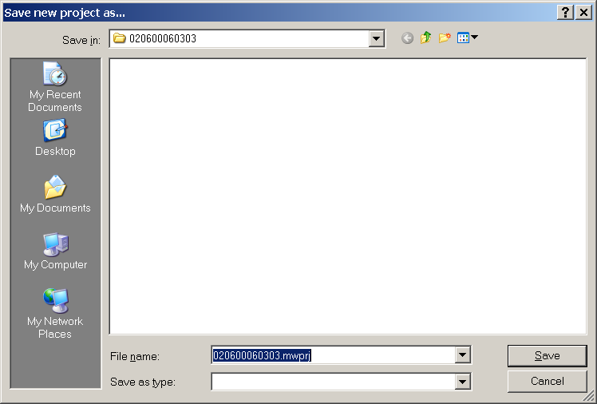
Save New Project As…
  File dialog will default to the HUC-12 number
  Project will be stored a folder named \SDMProjectBuilder\data\<HUC-12>
  Click ‘Save’ to continue

Slide 11
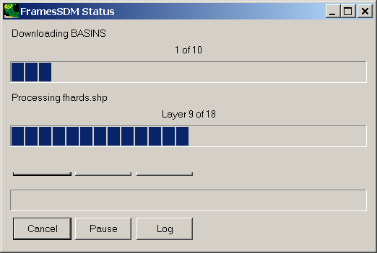
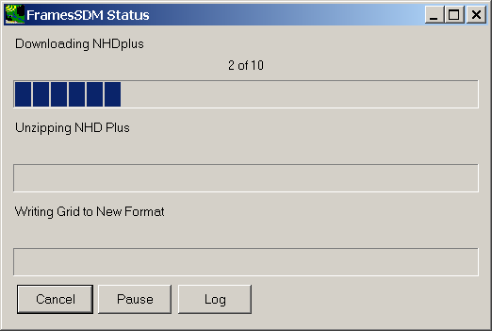
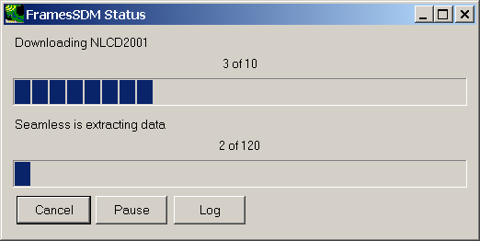
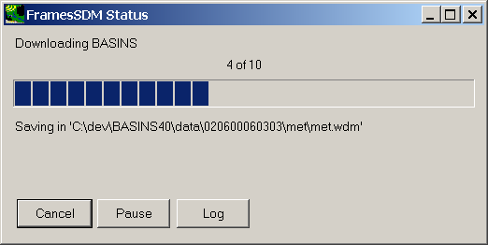
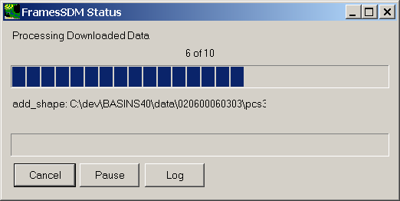
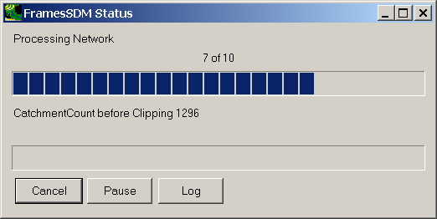
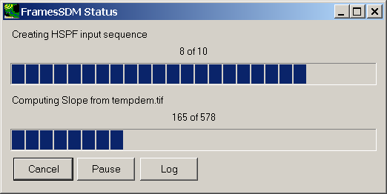
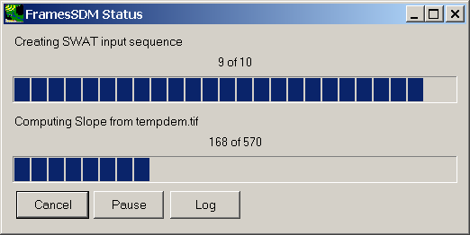
Status Messages
Multi-tiered status messages will display progress
  Downloading BASINS data, NHDPlus, and NLCD2001
  Processing and projecting data
  Processing stream network
  Creating HSPF and SWAT input sequences

Slide 12
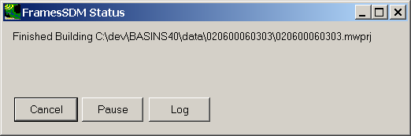
‘Finished Building’ Message
Appears when specified models have been built

Slide 13
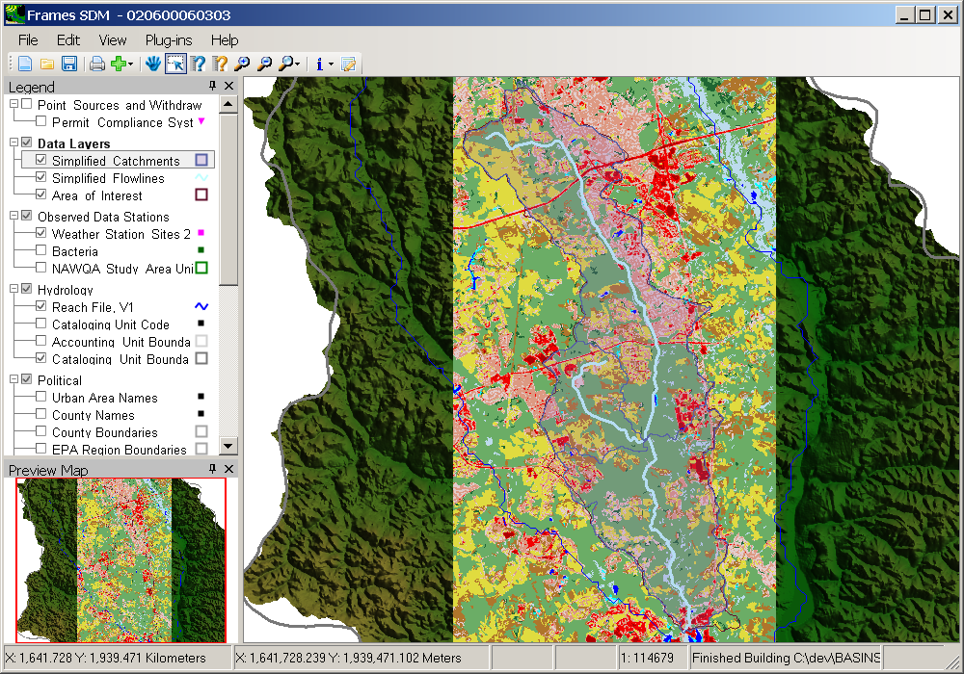
FRAMES SDM Project Builder
When complete:
  GIS layers can be viewed
  Select File:Exit to close the FRAMES SDM Project Builder

